Slide 1
QUINE’S METHOD
Ex: 7.8 / Name: Bulat Jaclina-Iana / Group: 911

Slide 2
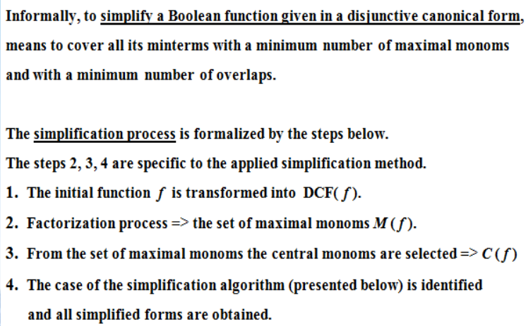
Simplification of boolean functions

Slide 3
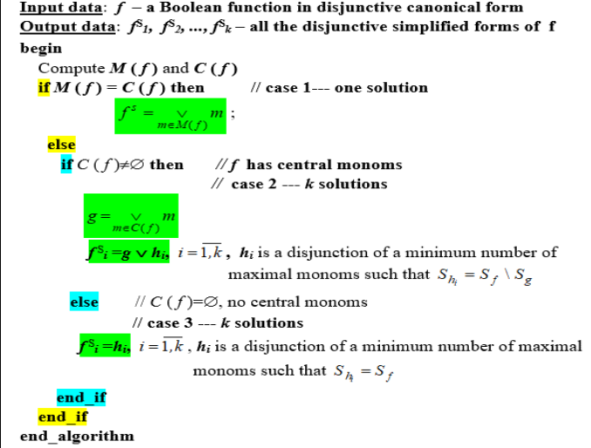
General simplification algorithm

Slide 4
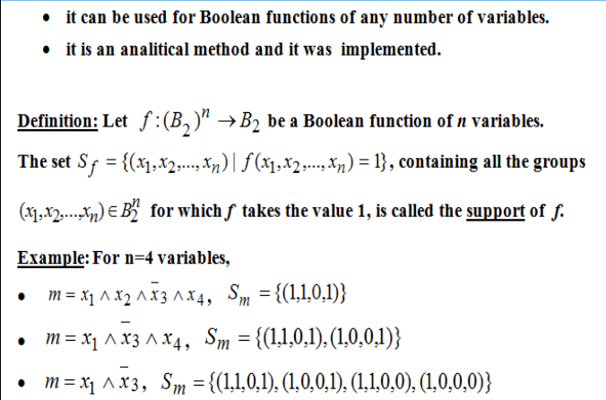
Quine’s method

Slide 5
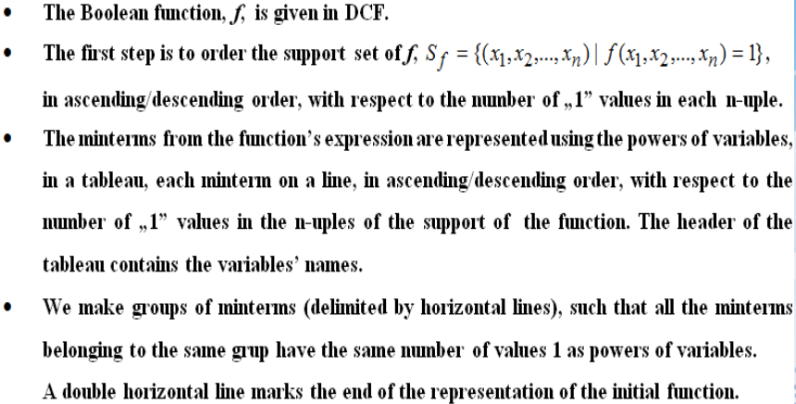
Steps in order to simplify a boolean function

Slide 6
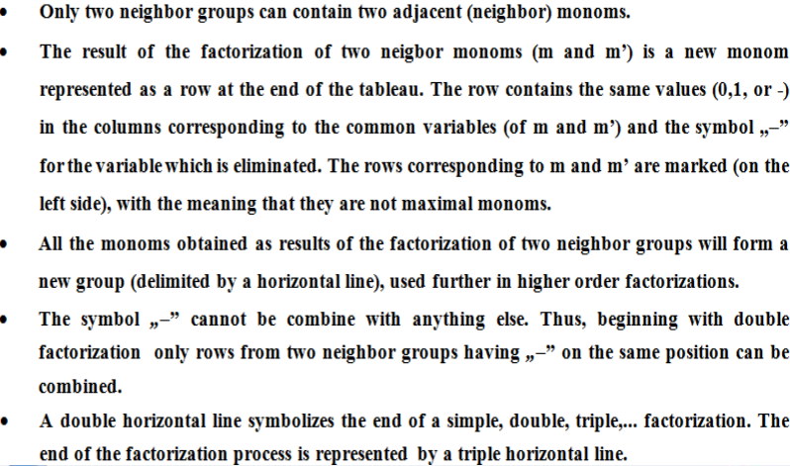
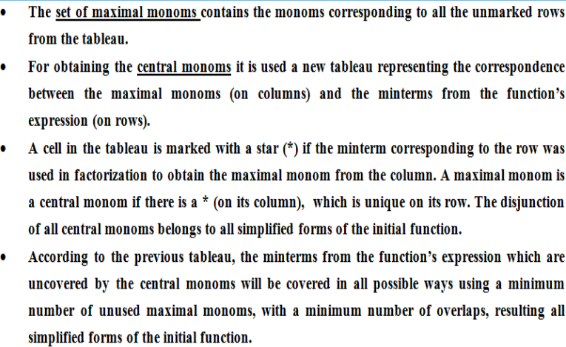

Slide 7
Exercise 7.8
Simplify the following Boolean functions of 4 variables given by their values 1, using Quine’s method.
f₈(1,1,1,1) = f₈(1,1,1,0) = f₈(1,1,0,0) = f₈(1,0,0,0) = f₈(0,0,0,0) = f₈(0,0,1,0) = f₈(1,0,1,1) = f₈(0,0,1,1) = 1

Slide 8
Exercise 7.8 Solution
Firstly we create a table to clarify which are our minterms.
Minterms | x1 | x2 | x3 | X4
m0 | 0 | 0 | 0 | 0
m2 | 0 | 0 | 1 | 0
m3 | 0 | 0 | 1 | 1
m8 | 1 | 0 | 0 | 0
m11 | 1 | 0 | 1 | 1
m12 | 1 | 1 | 0 | 0
m14 | 1 | 1 | 1 | 0
m15 | 1 | 1 | 1 | 1

Slide 9
Exercise 7.8 Solution
Then we group them by the number of 1s that we have in each number.
Group | Minterms | x1 | x2 | x3 | x4
0 | m0 | 0 | 0 | 0 | 0
I | m2 | 0 | 0 | 1 | 0
 | m8 | 1 | 0 | 0 | 0
II | m3 | 0 | 0 | 1 | 1
 | m12 | 1 | 1 | 0 | 0
III | m11 | 1 | 0 | 1 | 1
 | m14 | 1 | 1 | 1 | 0
IV | m15 | 1 | 1 | 1 | 1

Slide 10
Exercise 7.8
Then we intersect the groups to minimize the number of maxterms that we have. If we would try to intersect again the groups in this table, we will remain with no maxterms at all, so this table is our end to finding the maxterms.
Group | Minterms | x1 | x2 | x3 | x4 | Maxterms
V = 0 + I | m0, m2 | 0 | 0 | - | 0 | max1
 | m0, m8 | - | 0 | 0 | 0 | max2
VI = I + II | m2, m3 | 0 | 0 | 1 | - | max3
 | m8, m12 | 1 | - | 0 | 0 | max4
VII = II + III | m3, m11 | - | 0 | 1 | 1 | max5
 | m12, m14 | 1 | 1 | - | 0 | max6
VIII = III + IV | m11, m15 | 1 | - | 1 | 1 | max7
 | m14, m15 | 1 | 1 | 1 | - | max8

Slide 11
Exercise 7.8 Solution
 | max1 | max2 | max3 | max4 | max5 | max6 | max7 | max8
m0 | * | *
m2 | * |  | *
m3 |  |  | * |  | *
m8 |  | * |  | *
m11 |  |  |  |  | * |  | *
m12 |  |  |  | * |  | *
m14 |  |  |  |  |  | * |  | *
m15 |  |  |  |  |  |  | * | *
This table shows us which maxterm is made out of which minterms.
We can observe that there is no (*) unique on any certain row, all the minterms are covered by 2 maximal points.
f1(x1,x2,x3,x4) = max2 V max3 V max6 V max7 = x2 x3 x4 V x1 x2 x3 V x1 x2 x4 V x1 x3 x4
f2(x1,x2,x3,x4) = max1 V max4 V max5 V max8 = x1 x2 x4 V x1 x3 x4 V x2 x3 x4 V x1 x2 x3

Slide 12
Thank you

